Slide 1
Resident Relations, Customer Service and Conflict Resolution
Making a Difference and Setting the Standard

Slide 2
Resident Relations
What will you learn?
  Importance of Resident Relations
  Attending to the “Little Things”
  Retaining Residents
  Actions to Take to Retain Residents

Slide 3
Importance of Resident Relations
Professional habits are the responsibility of each employee and are to be used to meet customer expectations.
Residents have the right to demand the finest service.
Residents should always be greeted promptly and warmly receiving our full, undivided attention.

Slide 4

Importance of Resident Relations
Attending to the “little things” goes a long way in establishing a positive customer service program at your community.
What can you do to brighten a resident’s day?
  Respond to all letters or phone calls the same day.
  Using a resident’s name in the greeting or during the conversation.
  Taking a personal interest.
  Being helpful when needed.
  Delivering a package or their mail.
  Going the extra mile in helping a new resident with the move in process.

Slide 5
Why Should We Retain Residents?
PROFIT POTENTIAL = SOLID RESIDENT RETENTION PROGRAM
Retaining Residents reduces turnover costs.
It is 7 times more expensive to find a new resident than it is to keep a current one.
    70% of customers are lost due to lack of personal contact.
    Between 65%-70% of apartments are turned over each year. Can you think of an industry that loses more than two thirds of its customers every year?
    Average turnover costs across the country range from $2000-$3000 per home including lost rent!
    Fewer turnovers = less operating expenses

Slide 6
Basic Resident Retention Actions
Personal Contact – the fastest way to increase resident retention is to change the way you interact with your residents. Be sure to have more POSITIVE interactions with residents than NEGATIVE.
    Leaving Welcome Letter on the counter when they move in.
    Leaving a thank you letter with each completed service request.
    Offer Move-In-How-To-Notes when a resident moves in – such as how to set the microwave clock, stove clock, how to reset the garbage disposal, how to work the dishwasher, etc.
    Sending birthday cards or notes when something really big occurs.
    A personal note or candy with a renewal letter.

Slide 7
Basic Resident Retention Actions
Use the Resident Retention Feature in OneSite!
      Resident Call Back Log
      Reminder to add the personal touch
Service Request Call Back Program
      Fundamental to establishing a successful retention program
      Call residents within 48 hours after the service request is complete
      Ensure satisfaction
Personal Calls on all Notices to Vacate
      Every notice to vacate should receive a personal phone call from the Manager
Package Acceptance
Communicate Effectively and Positively!

Slide 8
Customer Service
What will you learn?
  The Importance of Good Customer Service
  10 Rules for Good Customer Service
  Customer Service Truths

Slide 9

Importance of Good Customer Service
Good customer service is the lifeblood for any business!
We can offer special rates,
look and lease incentives to
bring in as many new residents
as we want, but unless we get
some of those residents to
renew, the property’s
profitability will surely suffer.

Slide 10
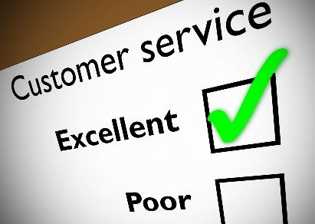
10 Rules for Good Customer Service
Know who is Boss! Never forget that the customer pays our salary and makes your job possible.
Be an Active Listener! Take the time to identify customer needs by asking questions and concentrating on what the customer is really saying.
Be Aware. Be aware of a customer’s words, tone of voice, body language and most importantly, how they feel.
Identify and Anticipate Needs. Customers don’t buy good products or services. They buy good feelings and solutions to problems. Emotional rather than logical.
Make Customers Feel Important and Appreciated. Treat them as individuals. Always use their name and find ways to compliment them, but be sincere.
UNDER PROMISE AND OVER DELIVER!
Appreciate the Power of YES! Be helpful, courteous and knowledgeable – even if there is no immediate profit in it!
Know How to Apologize. When something goes wrong, apologize. It is easy and customers like it! Deal with problems immediately!
Go the Extra Mile!
Treat Your Co-Workers Well. We are Westwood’s internal customers and need regular doses of appreciation. Thank each other and find ways to let others know how important they are. Treat your co-workers with respect and chances are they will have a higher regard for customers.

Slide 11
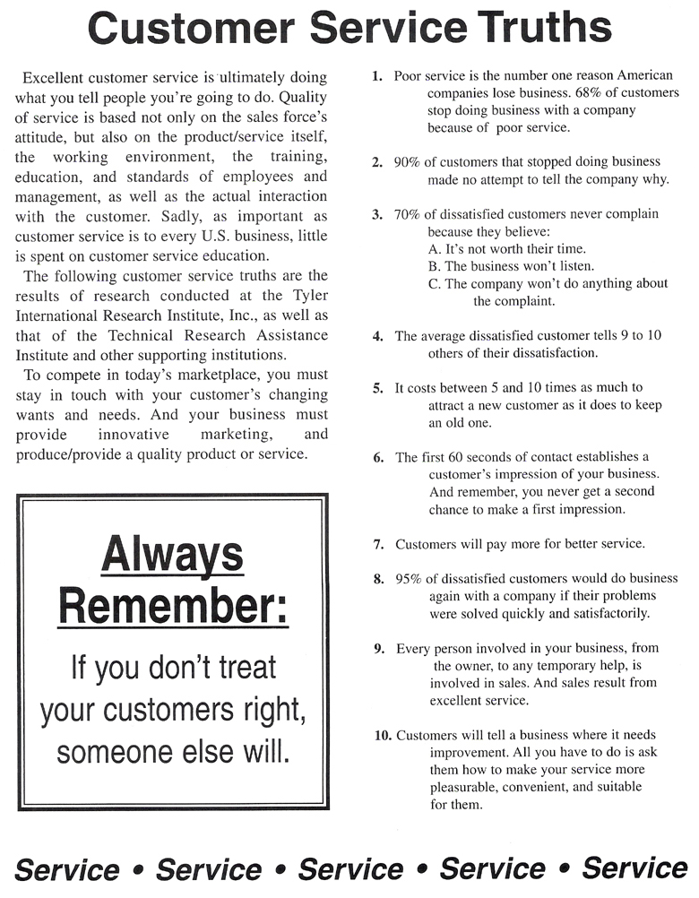
Customer Service Truths

Slide 12
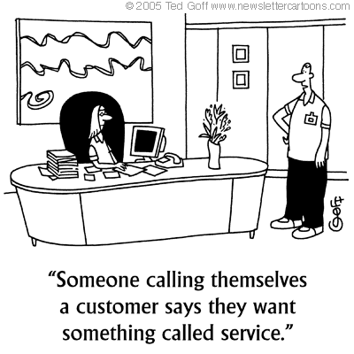
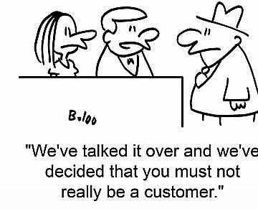
Customer Service Funnies
THE CUSTOMER IS ALWAYS RIGHT

Slide 13
Conflict Resolution
What will you learn?
  Understanding the Circle of Conflict and Why People Are the Way They Are.
  The Goal of Conflict Resolution
  Fostering an Honest Relationship with Residents
  6 Steps to Problem Solving
  How to Solve Resident Complaints with One Another
  Conflict Resolution Tips

Slide 14
CIRCLE OF CONFLICT
Relationships
External Moods
Structure
Interests
Data
Values
Past negative experiences
Stereo types
Repetitive negative behavior
Factors unrelated to dispute
Psychological or physiological
Bad Hair days and the like
Limited physical resources (time, $$)
Authority Issues
Each party’s wants, needs, fears, hopes, and concerns
Lack of information
Misinformation
Too much information
Belief systems
Right vs. Wrong
Good vs. Evil
Just vs. Unjust

Slide 15

Conflict Resolution
What is the #1 Goal to Achieve when a Complaint is Received?
To Resolve the Problem Courteously, Efficiently and Promptly!
No one likes to be “sold to”, if you did something wrong, admit it, apologize and move towards finding a resolution.
If you are unable to resolve a conflict, admit it and if you need more help, or more time to resolve the situation, ask for it!

Slide 16
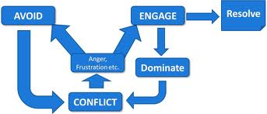
THREE PHRASES THAT HELP DEVELOP A MORE HONEST RELATIONSHIP WITH RESIDENTS
“I was wrong.” No one wants to admit they were wrong. The fastest way to take the steam out of arguments and objections is to admit your error. Admit it and move on to resolving the situation.
“I am not sure of the answer, but I can find out for you”. If you don’t know the answer, tell the resident that. This helps establish credibility believe it or not! If you are truthful with the person, they are more apt to trust you. Trust = Credibility
“I need help or more time to find out.” If you cannot answer a question, can’t get your hands on the part to fix the resident’s sink admit it. Most people will be patient if you are honest. If it’s the truth, they may still be mad, but, again, most of the steam is taken out of the anger when you are honest.

Slide 17

6 STEPS OF PROBLEM SOLVING
  Get the Facts
    Let the resident speak.
    Listen without interruption until the resident has fully described the problem.
    Once the problem has been stated, ask questions to insure a complete understanding of the problem. Do not ask questions in an accusatory manner, but simply ascertain the facts.
Define the Problem - Restate the problem after the questions have been asked to insure that you have clearly understood the resident.
Generate Alternatives - Move quickly to generate alternatives and agree on a solution.
Select a Solution - Select the solution that will give the best outcome for all involved. Remember, the resident’s problem is your responsibility until it is solved. Inform the resident of how the situation will be handled.

Slide 18
6 STEPS OF PROBLEM SOLVING
Implement
    Take action steps to correct the problem as soon as possible.
    Write a summary of what was discussed with the resident. Date it and place it in the resident’s file. The Property Manager should be informed of the resident’s complaint.
    Follow-Up
    Put in a courtesy call to follow-up with the resident (within 24 hours, whenever possible) to insure that the action taken has resolved the problem and that the resident is satisfied.
    Ask yourself if you have done the best you could for this resident. Learn from each experience.
    Document the entire exchange with the resident on the Conversation Log.

Slide 19
Resident Complaints Involving Another Resident
Avoid being “in the middle”. Suggest the resident call the problem to their neighbor’s attention.
Here are some guidelines:
Do not automatically assume that the resident you are contacting is creating a problem. Contact him or her in a questioning, rather than accusing, manner.
Begin with a phone call and document the conversation and follow-up with a letter.
If there has been a violation, state it in a straight-forward manner - you are carrying out a policy designed to improve the apartment lifestyle for all concerned.
If all efforts to persuade a resident to live within our policies fail, either proper legal action should be taken to immediately remove the resident, or the lease should not be renewed.

Slide 20
Conflict Resolution Tips!
IMPORTANT!
Control your behavior at all times.
Do not get defensive.
Stay positive.
You should speak in even, calm tones in order to set an appropriate pattern for the exchange.
If, when dealing with an irate resident, you are afraid of losing your temper, you should excuse yourself for a few minutes or ask the resident to come back when the situation can be discussed rationally.
If an irate resident becomes threatening or abusive, he should be asked to leave the office until he can calm down and discuss the matter reasonably.

Slide 21
Q & A
Thank you for your participation!

